Slide 1

Welcome to Jellyfish Class
2024-25

Slide 2
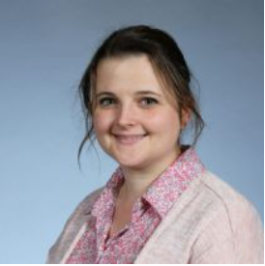
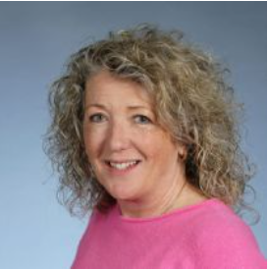
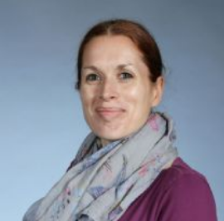
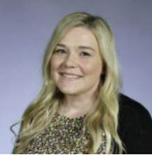
Staff
Mrs Zalman
Class Teacher
Ms England
Teaching Assistant
Mrs Gregg
Learning Support Assistant
Mrs Beagle
Thursday afternoons

Slide 3
Expectations
We expect your child to come to school ready to learn
Healthy breakfast
Correct uniform – smart and clean and each item named
Regular attendance unless they are really ill
Drop off and collect your child on time – revision and phonics
Please let us know if another adult will be collecting your child
Please make appointments out of school time
Help your child to practise buttons, zips, tights, collars (NO LACED SHOES PLEASE – including trainers for PE)

Slide 4
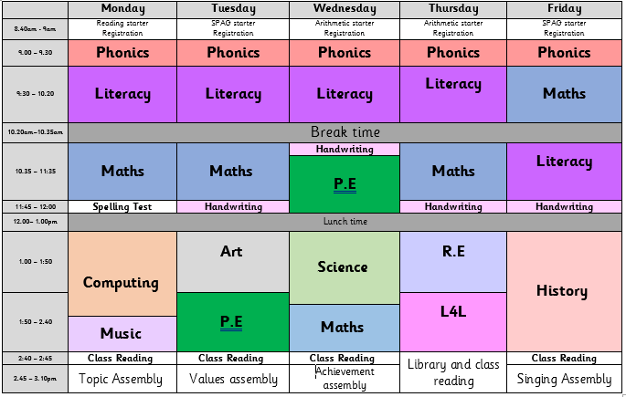
Daily Routine

Slide 5
What to bring everyday
Reading diaries and books
Phonics folders with phonics books
(these will need to be paid for if they are damaged or lost)
Named Bottle of cold water
Small book bag
Named uniform (this includes tights and not leggings)
Fruit is provided but they can still bring their own
Any food brought into school (including any treats for birthdays) must be nut free.
No rucksacks
No big hair accessories (these should be school colour)
No smart watches

Slide 6

P.E
Twice a week – Autumn = Tuesdays and Wednesdays
Named PE kit– plain navy blue/black shorts or jogging bottoms, light blue Maybury t-shirt, trainers with Velcro.
Hooded PE sweatshirt (not school jumper)
No earrings or jewellery
Provide a doctors note to excuse your child from PE
PE days change to give opportunities to work with the PE specialist.

Slide 7

Reading
Read at least 3 times a week with your child at home and sign their reading diary.
Children who read every day at home make much better progress
Write in your child’s reading diary when reading at home (title, pages, comment)
Children will change their book on Mondays if they are reading the RWI books.
Focus on comprehension as well as reading (asking questions and talking )
Phonics books are changed every 3 or 5 days but phonics folders and reading diaries should still come in every day.
Access online books and comprehension questions on Bug Club
Books available online on Oxford Owl.

Slide 8

Writing
Ensure you have pens, pencils, a ruler and rubber at home
Encourage your child to write for fun at home – stories, shopping lists, letters, cards, postcards, instructions, poems, songs
Help them consolidate their literacy learning by putting their phonics, grammar and reading skills into practice
Practise spelling – spelling tests are on Mondays.
Encourage them to hold a pencil correctly
Spellings games for practising can be found on EdShed.

Slide 9

Maths
Play dice games
Take your child shopping and talk about the quantities of anything you buy
Let your child handle money and work out how much things cost
Look together for numbers on street signs and car registration plates
Practise and talk about telling the time
Do cooking and baking together, weigh foods and talk about temperatures and times needed to cook foods
Count toys, books, buttons, etc. in 2s, 3s, 5s and 10s and play Times Table Rock Stars at home.

Slide 10
Home Learning
Maths and Grammar home learning go out every week. These will be CGP books that go out on a Tuesday and need to be returned on the following Monday. Pages to be completed will be put on the Jellyfish Class Page of the website. Please take care of these books.
Online resources: Bug club, Oxford Owl, Times Tables Rockstars, Edshed.
Allow some time to help your child
Turn off the TV
Don't let homework become a chore. Keep it fun and make it a special time that you both look forward to

Slide 11
Our Learning for Autumn 1
Maths
Place value, addition and subtraction, money
Literacy
Adjectives, expanded noun phrases, punctuation
History
Brooklands and Brooklands Museum trip in October
Computing
What is IT?
Art
Paul Klee and tessellation

Slide 12
DT money
We make model cars with working wheels and axels, waterproof shelters and healthy sandwiches.
Please send in your £5 contribution so we can purchase resources and food throughout the year for these topics.
Thank you for contributions so far.

Slide 13
Knowledge organisers
For each topic
Please read through with your child
Key vocabulary is very important
These are now found in the reading diaries

Slide 14
And finally…
Check the school website regularly
Please check emails and the Jellyfish notice board regularly
Please let us know of any changes at home that may affect your child at school, such as moving house or having a new baby
Please do phone the school office or email us if you have any questions, worries or concerns
We look forward to a fun year together in Year 2.

