Slide 1

Our Beliefs at Maybury
As a school council we decided to find out about the beliefs of the children in our school. It was very interesting to discover there are 4 main religions people at Maybury follow. We did some research to find out some important things about them.

Slide 2

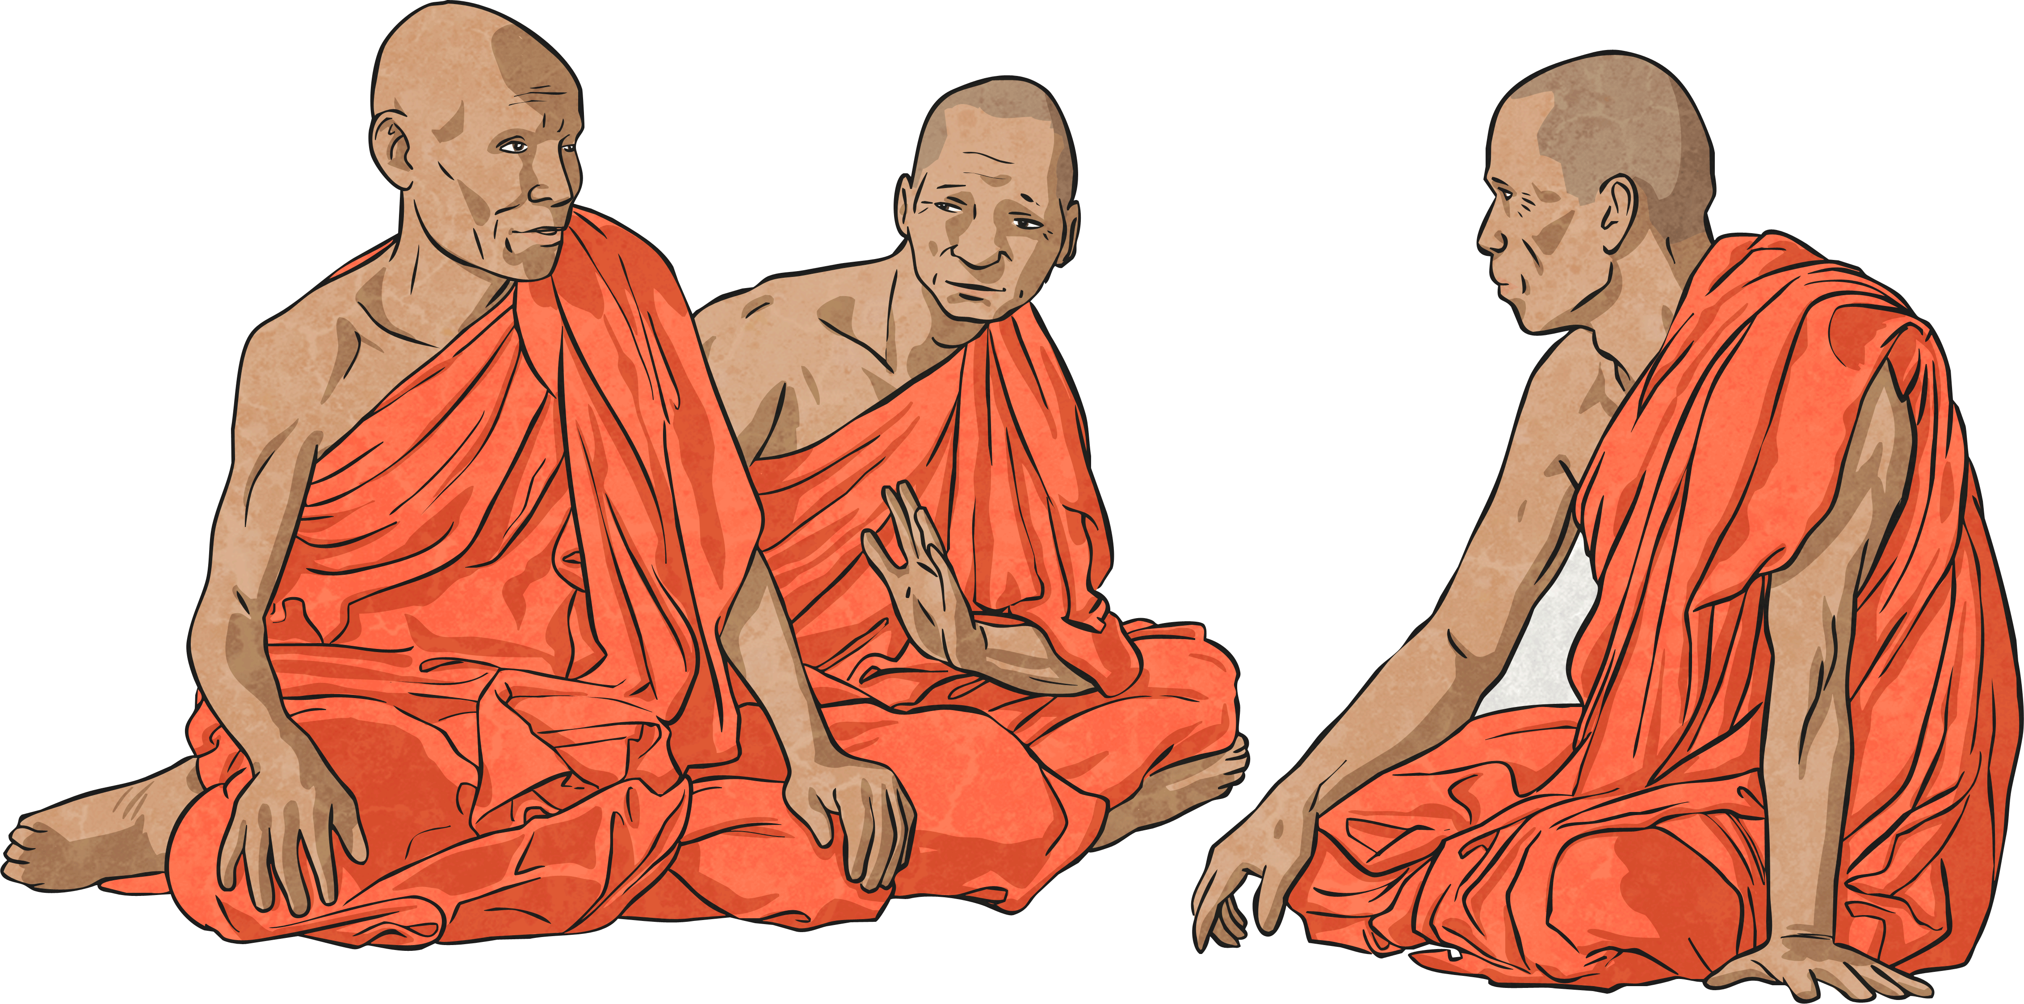
Buddhism
6 children
Who they worship- Buddha
Holy book- Not one special book but sacred texts
Place of worship- Buddhist Temple
Special festivals- Buddha Day in May
Special clothing- Kashaya robes and samue

Slide 3
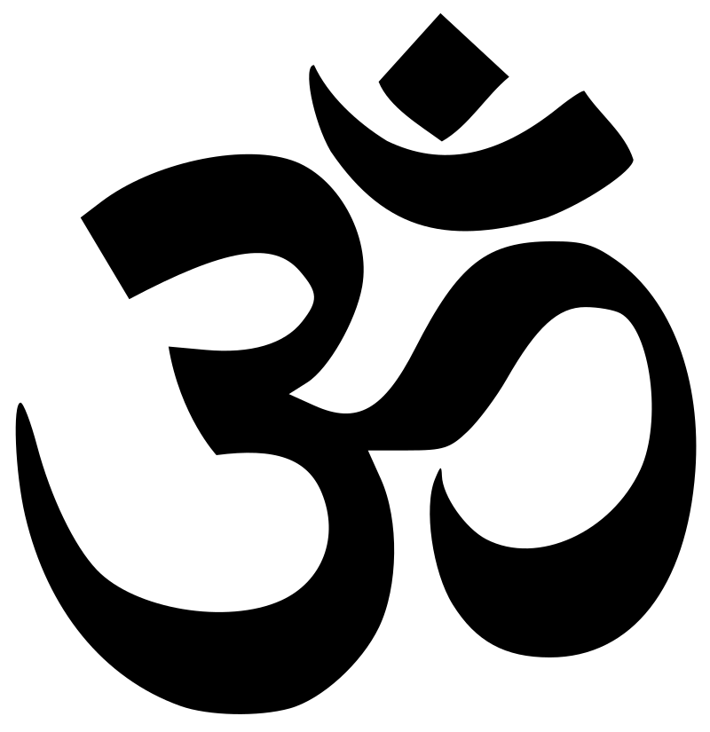
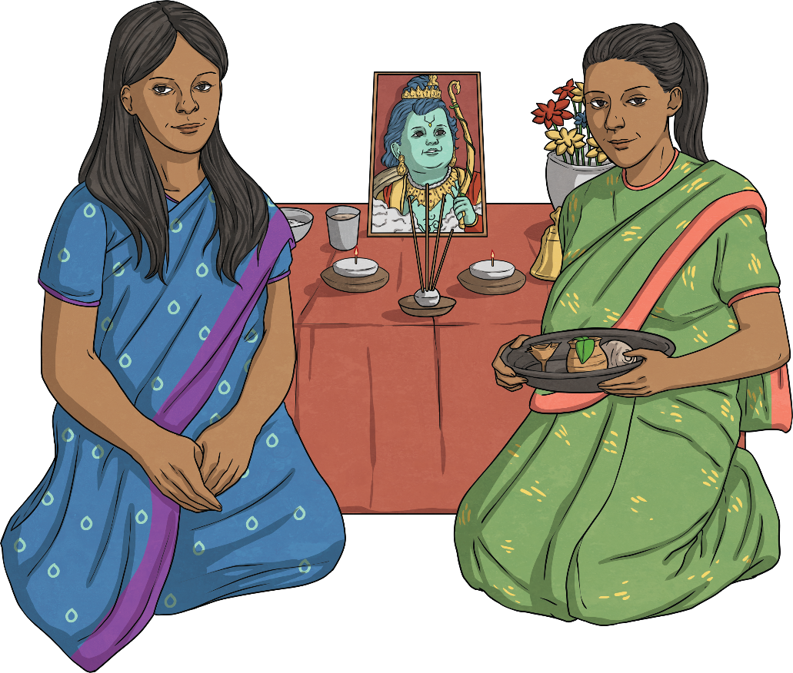
Hinduism
23 children
Who they worship- Brahma, Vishnu and Shiva
Holy book- Not one special book but sacred scriptures
Place of worship- Mandir (Temple)
Special festivals- 3 main celebrations: Diwali, Holi and Dussehra
Special clothing- Saris, lehengas and salwar kameez for women and men wear dhotis, kurtas, or sherwanis

Slide 4

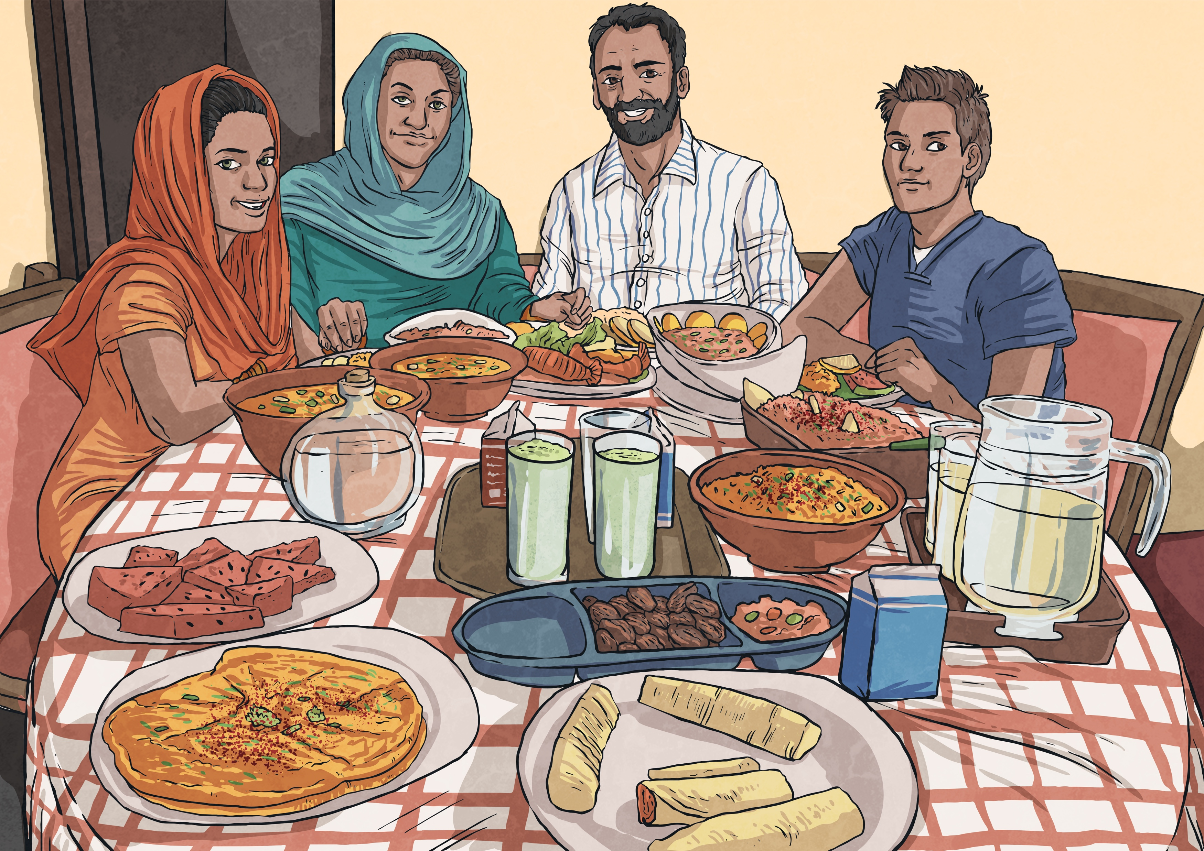
Islam
158 children
Who they worship- Allah
Holy book- The Qur’an
Place of worship- Mosque
Special festivals- 2 main celebrations: Eid ul-Fitr, Eid ul-Adha
Special clothing- Hijab for women and men wear robes called thobe or jubba

Slide 5

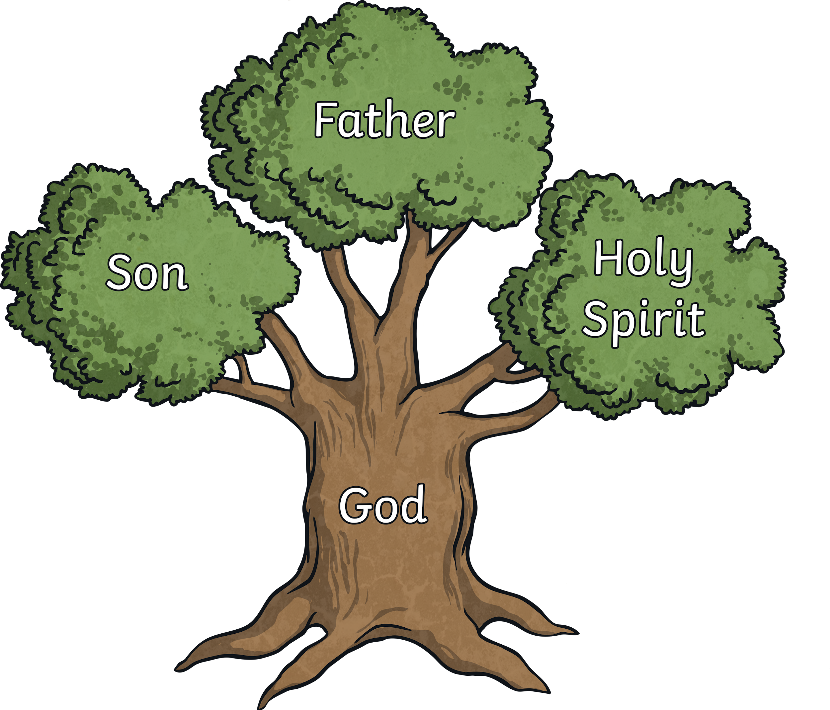
Christianity
42 children
Who they worship- One God in 3 parts-the Father, the Son and the Holy spirit
Holy book- The Bible
Place of worship- Church
Special festivals- 2 main celebrations: Christmas and Easter
We have many different types of Christianity at Maybury. These include: Church Of England, Roman Catholic and Orthodox Catholic/Eastern Orthodox

